Slide 1
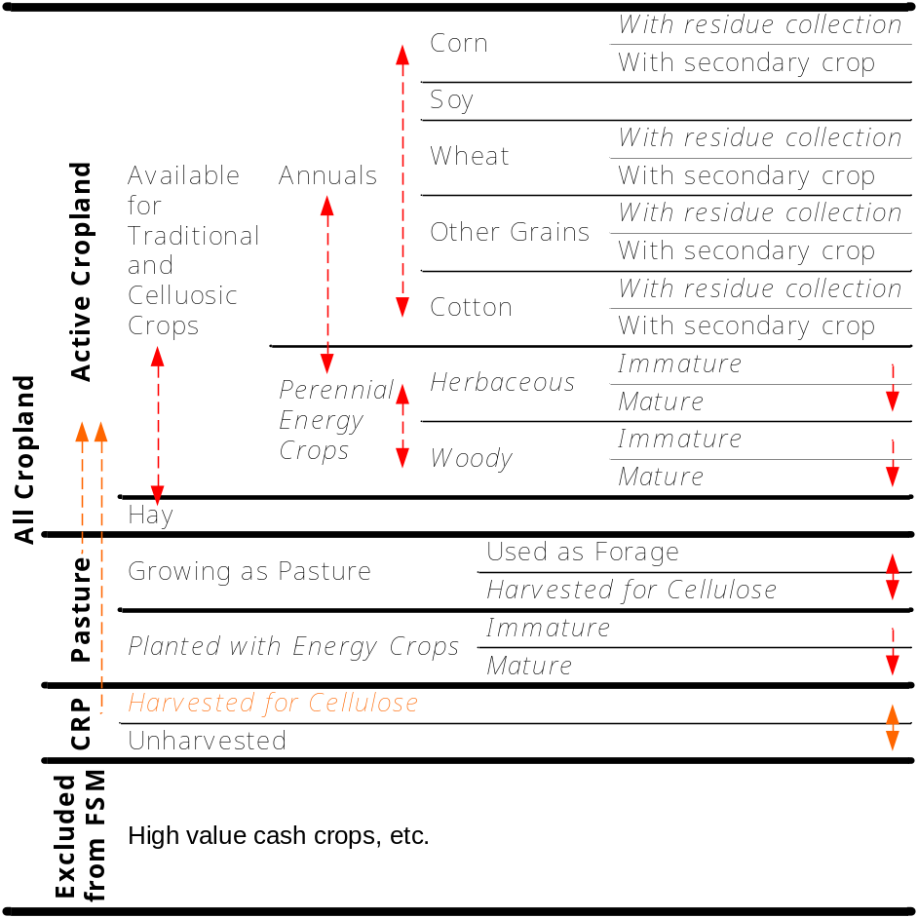
Land Allocation: Land Classification
BSM
GCAM | Units | BSM | BSM Area (Ac)
Biomass | km² * 1000 | Active Cropland | 252,000,000
Crops | km² * 1000 | Active Cropland | See above
Forest (managed) | km² * 1000 | NA | NA
Forest (unmanaged) | km² * 1000 | NA | NA
Grass | km² * 1000 | NA | NA
Other arable | km² * 1000 | NA | NA
Pasture (grazed) | km² * 1000 | Pasture | 47,000,000
Pasture (other) | km² * 1000 | Pasture | See above
Rock and desert | km² * 1000 | NA | NA
Shrubs | km² * 1000 | NA | NA
Tundra | km² * 1000 | NA | NA
Urban | km² * 1000 | NA | NA
NA | NA | CRP | 23,700,000
NA | NA | Hay land | 50,200,000

Slide 2
Land Allocation: Crops
GCAM | Units | BSM
Biomass | EJ | Perennial/Annual
Corn | Mg⁶ | Corn
Fiber Crop | Mg⁶ | Cotton
Fodder Grass | Mg⁶ | Hay
Fodder Herb | Mg⁶ | Hay
Misc Crop | Mg⁶ | NA
Oil Crop | Mg⁶ | Soy
Other Grain | Mg⁶ | Other grains
Palm fruit | Mg⁶ | NA
Pasture | Mg⁶ | Pasture
Rice | Mg⁶ | Other grains
Root tuber | Mg⁶ | NA
Sugar Crop | Mg⁶ | NA
Wheat | Mg⁶ | Wheat
BSM

Slide 3
BSM Initial Crop Yields (bu ac⁻¹)
Region | Corn | Soy | Wheat | Other grains
NE | 152 | 46.6 | 65.1 | 71.1
A | 134 | 39.5 | 64 | 81
SE | 153 | 35.7 | 54.6 | 0
DS | 184 | 45 | 60.7 | 100
CB | 173 | 50 | 62 | 74.9
LS | 180 | 46.8 | 61.9 | 65.6
NP | 158 | 41.1 | 41.6 | 64.9
SP | 148 | 25.7 | 30.7 | 61.9
M | 150 | 0 | 44.6 | 69.7
P | 157 | 0 | 72.9 | 73.7

